Slide 1
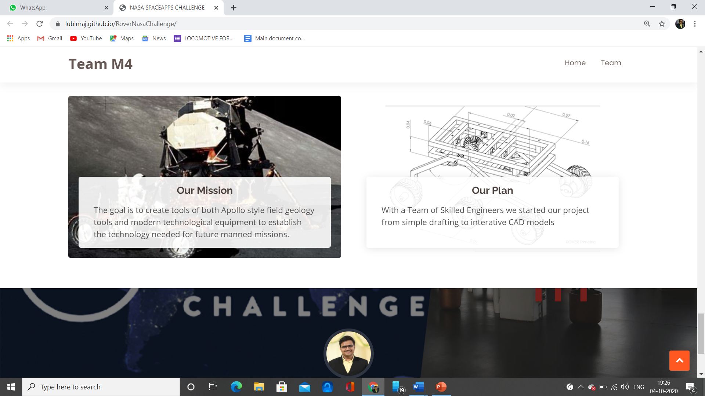
TEAM M4 – LIDAR ROVER
A PROJECT BY
LUBIN RAJ – MECHANICAL ENGINEERING
MOHAMED AKHEEL.M – MECHANICAL ENGINEERING
ASHIFFA SHERIN – HIGH SCHOOL GRADUATE
JAHNAVI – ELECTRICAL ENGINEERING
MOHAMED IBRAHIM – MECHANICAL ENGINEERING
SANTOSH AMAL JOSHUA.P – MECHANICAL ENGINEERING

Slide 2
SUMMARY
Our goal is to create interactive 3D geology tool for lunar and further planetary exploration.
We looked at Apollo-16 press kit to study the microwave instruments used and also the tools astronauts use to explore distant worlds by using remote operation in ideology of reducing astronaut mobility.
These tools are used to obtain samples (for which the tests are to be performed) and be placed in container and is remotely operated with the help of transmitter sensor and receiver sensor with Arduino.
Our final goal was to come up with a topography (content scanning ), using LIDAR concept, for a location by having multiple scans over the surface and also at different locations.
The underlying exploration driver for this field test was to establish the protocols and technology needed for an eventual manned mission.

Slide 3
COMPONENTS
ROVER: The Rover consists of 6 wheels which are used to provide linear motion to the vehicle.
LIDAR: The LIDAR is used to study the topography of a Planet. The LIDAR consists of a Laser light source, Converging lens to converge the light, Refining lens to refine the light and a Reflecting lens which is a 360 - degree lens that is used to reflect the laser beam to the object of the planet.
DRILL BIT: The Drill bit is used to initiate the Sample collecting process by drilling the surface using the remote control and the collection of sample is achieved by the Robotic arm.
ROBOTIC ARM: The Robotic arm is used to collect the samples (say Sand). The Robotic arm collects the sand sample from the crevices made by the drill bit and places it in the Container.
CONTAINER: The Container is used to hold the collected samples and analyze it.
The Rover is provided with an ANTENNA and an ARDUINO BASED CIRCUIT which are used to achieve the Remote control of the Vehicle.

Slide 4
WORKING MECHANISM
The rover which has a body and is supported on 6 wheels and the mechanisms in it is similar to a conventional ROVER.
The LIDAR mechanism for measuring the topography, consists of LASER source from which LASER is obtained through stimulated emission and is passed through a converging lens that produces a fine beam of LASER which in turn is passed through the refining lens and reflecting lens that reflects the LASER in 360 degrees. Thus we have a wide range of study.
The sand collection mechanism consists of a drill bit which drills into a surface guided by the drill pathway and is followed by the operation of the robotic arm that digs and collects sand which is stored in a container.
This entire mechanism is operated remotely with a help of antenna that detects the transmitted signal carrying the information from astronaut.

Slide 5
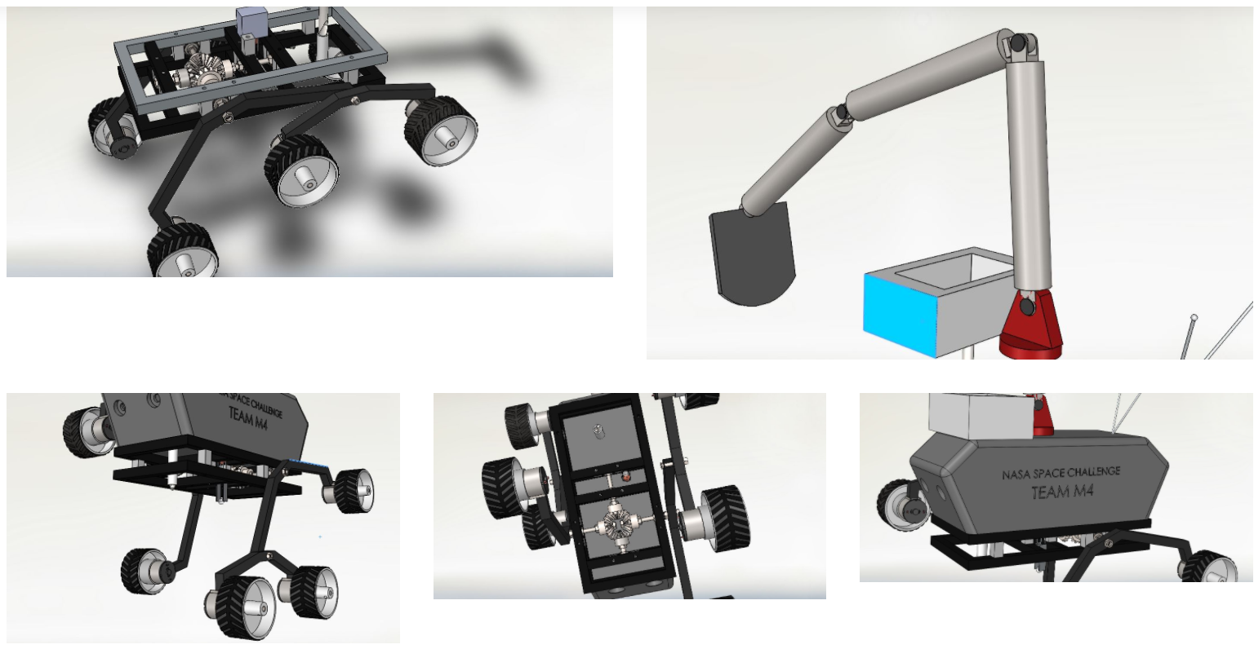

Slide 6
ADVANTAGES
Measurement of topography is made with equipment which has a reduced size.
Remote control is brought in so that astronauts can be idle (their mobility is reduced) in a place operating the rover.
Additionally the rover will also able to collect samples of sand for estimating various properties of it.
Inaccessible area can be accessed by this rover and so this could access almost all the areas.

Slide 7
APPLICATIONS
The mission's scientific objective was to search for and characterize a wide range of rocks and soils that hold clues to past water activity on external bodies.
Topography of the landscape is measured.
Search for iron-containing minerals, and to identify and quantify relative amounts of specific mineral types that contain water
Spectrometers to better characterize the composition of minerals on the surface: Alpha Particle X-Ray Spectrometer (APXS)
Radiation detectors to get a sense of how much radiation bathes the surface, which helps scientists understand if humans can explore there – and if microbes could survive there. These are Radiation Assessment Detector (RAD)
Assess whether those environments were conducive to life.

